Slide 1
Math

Slide 2
Math
Constants
Math functions
Trig functions
Rounding functions
Complex number functions
Matrix functions
Eigenvalues and eigenvectors

Slide 3
Constants Available
Constants
pi 3.14159…
inf infinity or 1/0
NaN not a number or 0/0 or inf/inf
i, j imaginary unit sqrt(-1)

Slide 4
Introduction to Math Operations
Common operations
  + addition
  - subtraction
  * multiplication
  / division
  ^ power
  () parentheses for order of operations
Nothing terribly surprising here

Slide 5
Introduction to Math Operations
There is a hierarchy or order that they are performed:
  Items in parentheses are computed first ()
  Next ^ is evaluated
  Next * and / are evaluated (left to right)
  Next + and - are evaluated (left to right)
Again, nothing terribly surprising here

Slide 6
Math Functions
Common Math Functions
  abs(x) absolute value of x
  sign(x) sign of x (1,0 or -1)
  sqrt(x) square root of x
  exp(x) exponential function or e^{x}
  log(x) natural logarithm of x
  log10(x) base ten logarithm of x

Slide 7
Trig Functions
Common Trig Functions
  sin(x) sine of x
  cos(x) cosine of x
  tan(x) tangent of x
  asin(x) arcsine of x
  acos(x) arccosine of x
  atan(x) arctangent of x
  atan2(y,x) arctangent with quadrant checks
Don’t forget to always use radians!!!

Slide 8
Radians!!!
It has been mentioned before, but it is worth emphasizing that angles inside a program should be in radians
During input convert degrees to radians
During output convert radians to degrees

Slide 9
Rounding Functions
Common Rounding Functions
  round(x) gives integer closest to x
  fix(x) gives the integer closest to x in the
  direction of 0
  floor(x) gives the closest integer below x
  ceil(x) gives the closest integer above x
Try -9.8 in each of the functions above

Slide 10
Complex Number Functions
Common Complex Functions
  real(z) gives the real part of z
  imag(z) gives the imaginary part of z
  abs(z) gives the magnitude of z
  angle(z) gives the phase angle of z
  conj(z) gives the complex conjugate of z
To create a complex variable use:
    z = 3 + 4i

Slide 11
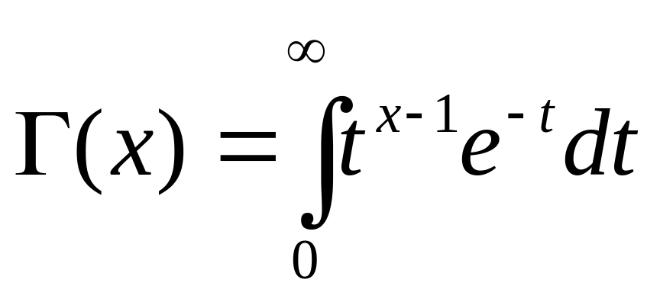
Special Funtions
Special Functions
  gamma(x) gives the gamma function

Slide 12
O.K. you may not need the gamma function

Slide 13
Matrix Functions
You can use many regular math functions
  + addition
  - subtraction
  * multiplication
  / division
  ^ power
  () parentheses for order of operations

Slide 14
Matrix Functions
Other matrix functions
  A’ the ‘ means transpose
  dot(x,y) dot vectors x and y
  cross(x,y) cross vectors x and y
  inv(A) inverse of matrix A
  det(A) determinant of A
  zeros(m,n) creates m x n matrix of zeros
  eye(n) creates n x n identity matrix

Slide 15
Eigenvalues and Eigenvectors
Eigen Functions
  [X,D]=eig(A)
Returns
  D eigenvalues of A on the diagonal
  X eigenvectors of A in the columns

Slide 16
Exercise
#1 Write the function mag.m. mag accepts a vector (V) and returns the magnitude (x) of the vector. Don’t forget to test your function.
function [x] = mag(V)

Slide 17
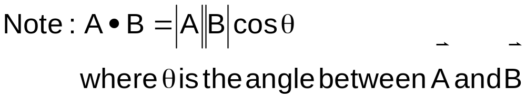
Exercise
#2 Write the function vecangle.m. vecangle accepts 2 vectors (V1,V2) and returns the angle between them (x).
function [x] = vecangle(V1,V2)

Slide 18
Summary
Constants
Math functions
Trig functions
Rounding functions
Complex number functions
Matrix functions
Eigenvalues and eigenvectors

